Slide 1


PANIMALAR ENGINEERING COLLEGE
DEPARTMENT OF COMPUTER SCIENCE AND ENGINEERING
CS8811 PROJECT WORK
STRENGTHENING CRYPTOGRAPHY USING QUANTUM PROPERTIES
Guide Name: Dr. Krishnamoorthy Team Members
BATCH NO: D8
NAVEEN S R | 211418104172
PRADEISH C | 211418104196
MOHAN RAJ RISHI S | 211418104158

Slide 2
ABSTRACT
For most of the cryptography algorithms, randomness plays a vital role. But generation of pure random number is impossible in classical computer. Even for generating decent random numbers it needed a random seed.
But since the seed is a number in source code or algorithm to generate seed which is also in source, it can be revealed to hacker if the system is compromised.
Which made possible to predict all the random numbers the computer will generate by the hacker. So, to solve this issue we introduce quantum computer to create a true randomness using its superposition capability.
But quantum machines are not accessible to all the computers, especially to clients.

Slide 3
PROBLEM STATEMENT
The Generation of pure random numbers from classical computing is impossible.
Most of the solutions, systems use the information link POSIX time, CPU status, internet traffic, etc., for random number generation.
Seed used for generation can be revealed, if the server is compromised and which can lead to retrieval of sensitive data.
Combination of retrieving server app source code and log and monitoring all the servers communication can lead to a massive cyber attack.

Slide 4
EXISTING SYTEM AND DISADVANTAGES
The Generation of pure random numbers from the classical computing is impossible.
If someone gives random number to the classical, it can be generated with the help of random number simultaneously. The first random number is called SEED
If anyone finds the SEED. What will be the random numbers that the computer generates can be predicted.
If a person gives SEED (1,2,3,4) and user give the SEED (1,2,3,4) what the person computer random number generated will same as our computer generates

Slide 5
PROPOSED SYSTEM
Using Quantum computing we can directly generate SEED(or) Cryptographic key.
The SEED generated in super position state comes as Definite random number.
Quantum computer is the only source to generate true random numbers.
No one can predict the SEED in Quantum computer because it is a true random.
No-Cloning principle says, there is no chances of clone this process.

Slide 6
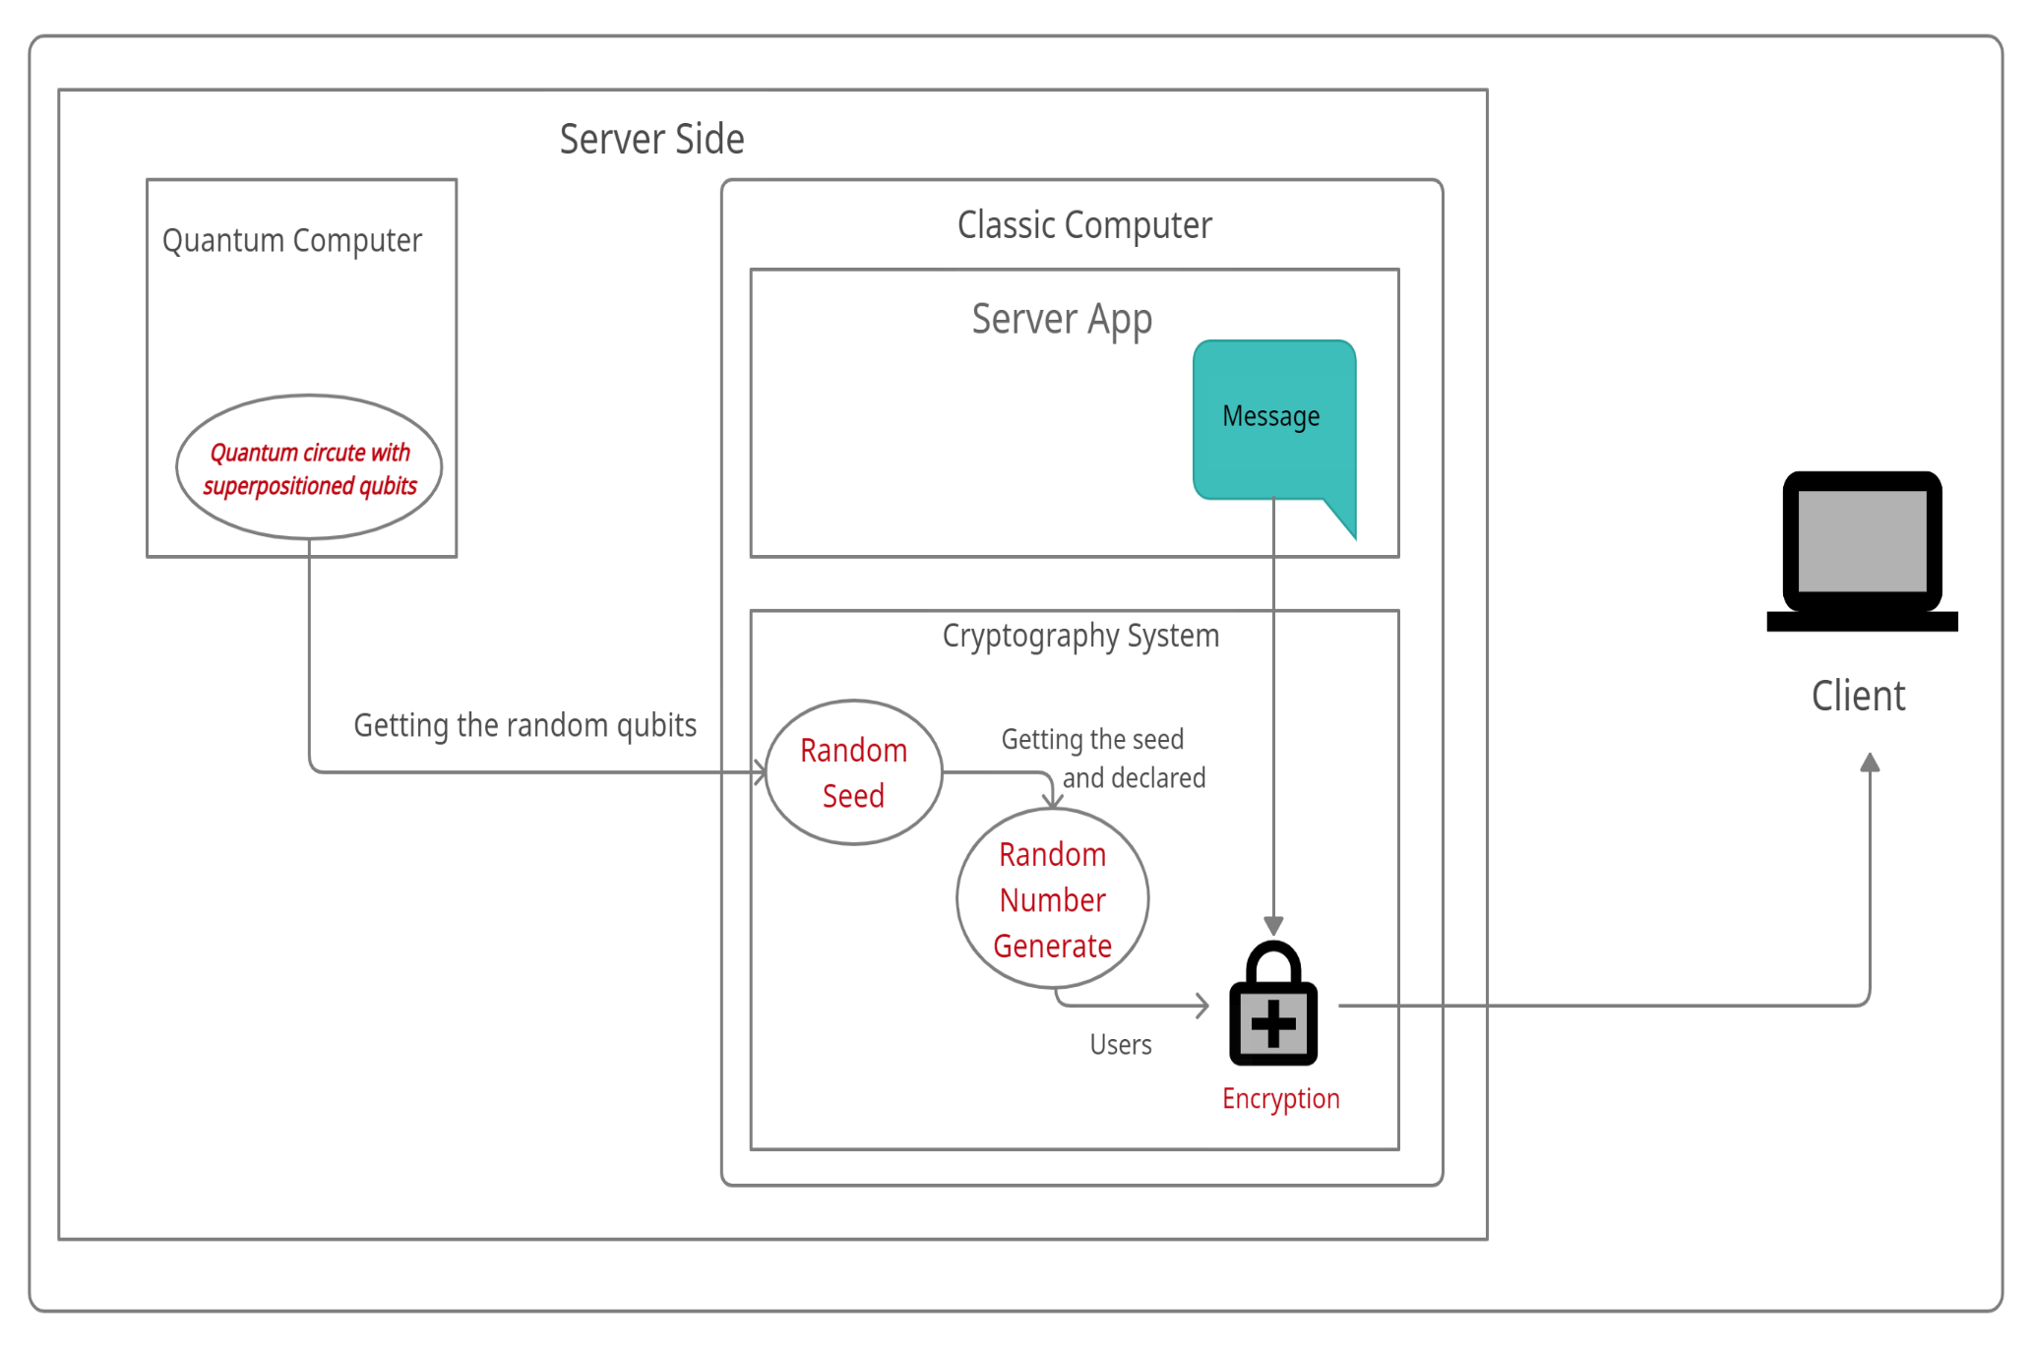
SYSTEM ARCHITECTURE

Slide 7
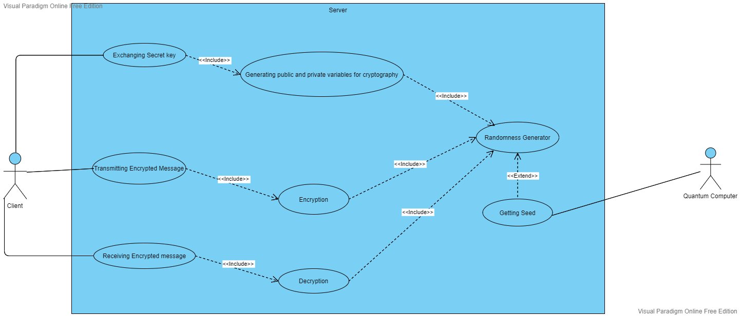
USE CASE DIAGRAM

Slide 8
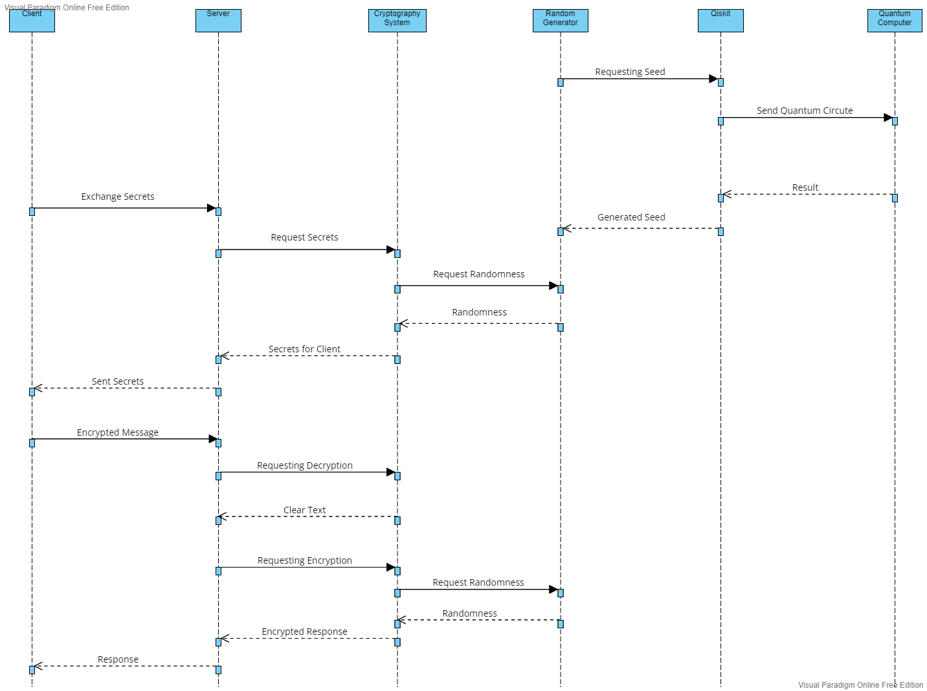
SEQUENCE DIAGRAM

Slide 9
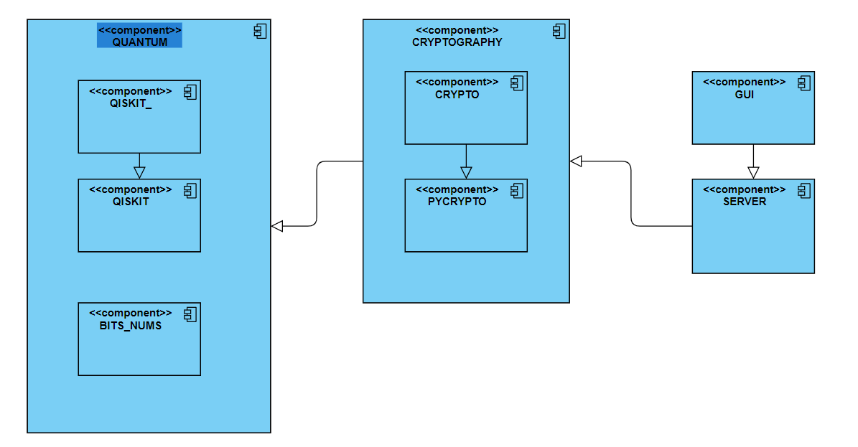
COMPOUND DIAGRAM

Slide 10
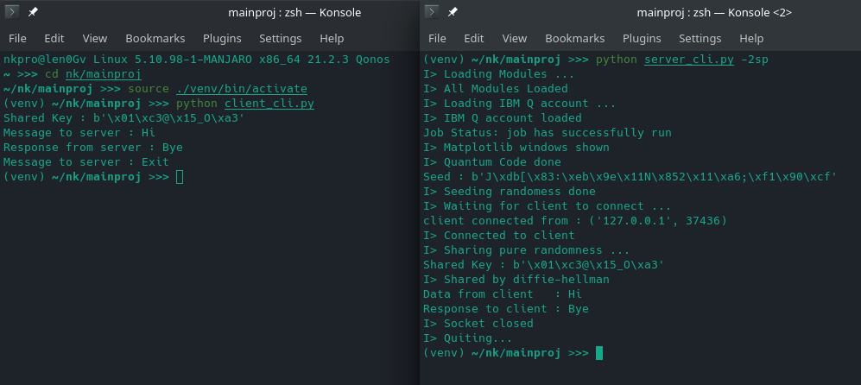
SAMPLE DEMO

Slide 11
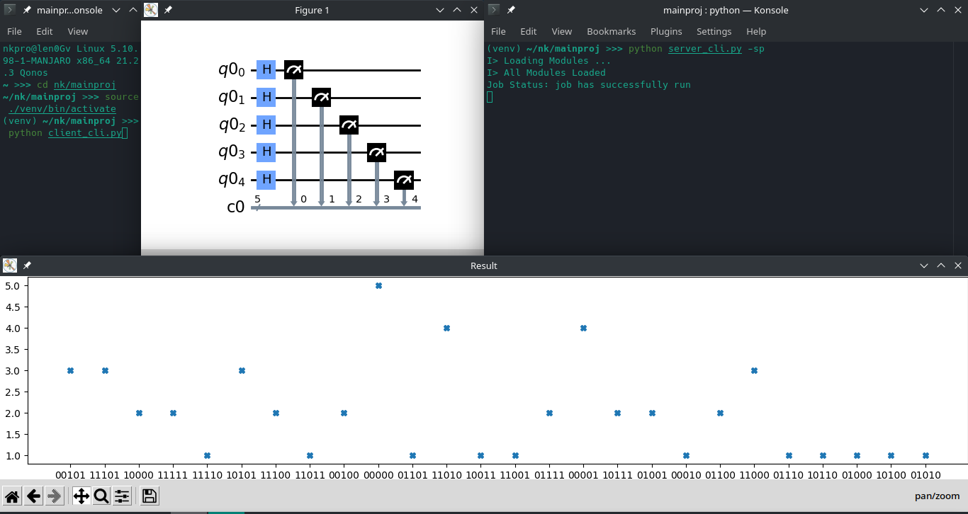
OUTPUT

Slide 12
TECHNOLOGY STACK
Quantum Computing.
Quantum Programming.
Python.
Qiskit.
IBM Quantum.
Pycryptodome.

Slide 13
FUTURE ENHANCEMENT
To create a generic algorithm to support all type of server-client protocols and cryptography techniques using the pure randomness (which is shared using proposed method)
To find out the efficient way to implement both the quantum computer and the previously mentioned algorithm to all the domestic and commercial servers

Slide 14
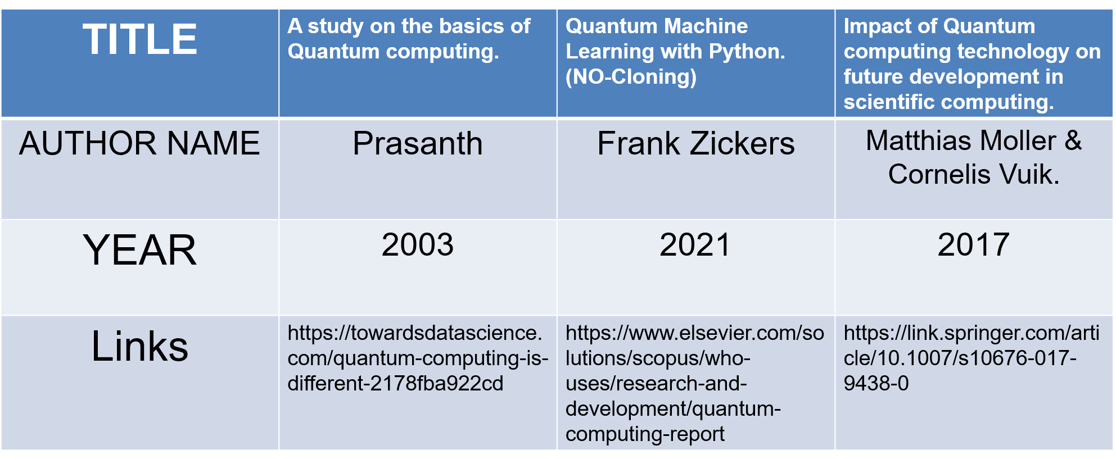
REFERENCE

Slide 15
CONCLUSION
With this proposed system the seed used for generate random number is secured and can't be revealed to any one because of we communication with quantum computer directly and not cached anywhere.
Also, with the help this method we can securely send true random number generated using quantum computer to client even in un-encrypted channel without any compromise.
Combination of retrieving server app source code and monitoring all the server communication can lead to a massive cyber-attack. Although these attacks are rare and hard to happen, there is no proof it can’t happen in future. So to prevent these kinds of attacks this project uses the quantum properties.

